Slide 1
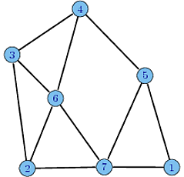
To identify the pair of parallel edges of the directed graph, if the graph is treated as undirected
Submitted by:
Anshul Anand (icm2014501) Akanshu Gupta (iwm2014501)
Amit khanna (iim2014004)

Slide 2
Problem:
An adjacency matrix of a directed graph G is given, We have to find out the pair of parallel edges of G, considering the graph G as undirected.

Slide 3
Keywords:
Parallel edges: Two vertices are considered as incident on each other if they are connected by same edge and the edges which have same pair of points as their end points are parallel edges.

Slide 4
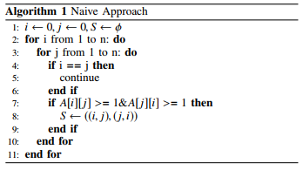
Algorithm 1 :
Naive Approach

Slide 5
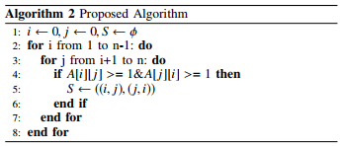
Algorithm 2:
Proposed approach

Slide 6
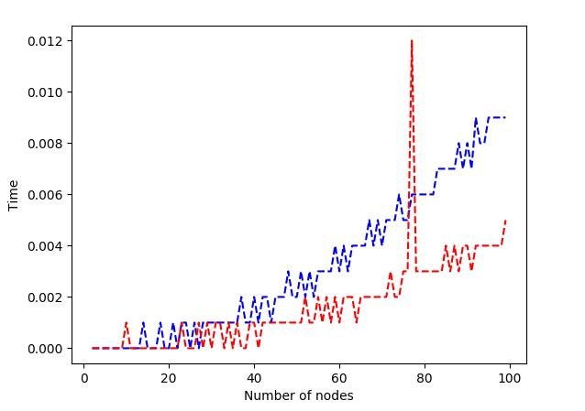
Results and Conclusion:
We evaluated our algorithms on 300 randomly generated graphs. ( In increasing size of nodes. )
For a graph with N number of nodes, time complexity to ﬁnd parallel edges is O(N*(N-1)/2)

